Slide 1
DETR – Deformable DETR – RT-DETR
Concept Presentation

Slide 2
References
Carion et al – Facebook AI, End-to-End Object Detection with Transformers, ECCV 2020.
Zhu et al – SenseTime Research (CN), Deformable DETR - Deformable Transformers for End-to-End Object Detection, ICLR 2021.
Lv et al – Baidu Inc., DETRs Beat YOLOs on Real-time Object Detection, arXiv 04/2023.

Slide 3
Transformer in Computer Vision
2 major model architectures in adopting transformer in CV:
Pure Transformer
ViT-based methods
Hybrid: CNNs + Transformer
DETR-based methods

Slide 4
Background
Previous Modern Object Detectors:
Rely on complex combination of hand-crafted components
Anchor generation
Non-maximum suppression (NMS) post-processing
Require manually adjustment for specific dataset
e.g., anchor size or NMS threshold.
→ Not fully end-to-end

Slide 5
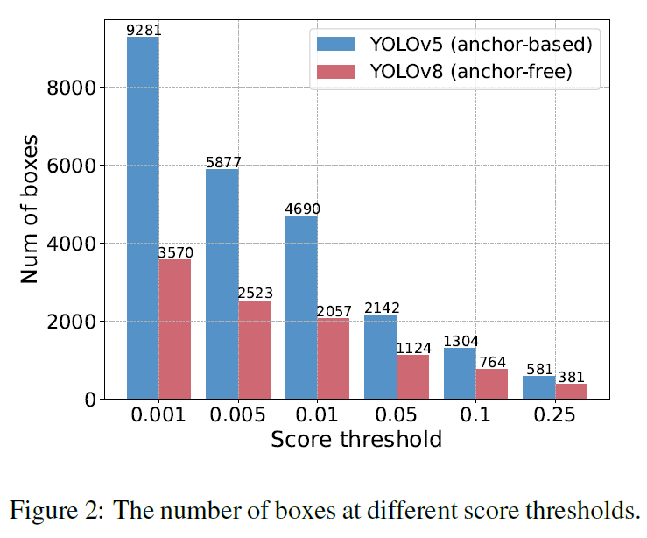
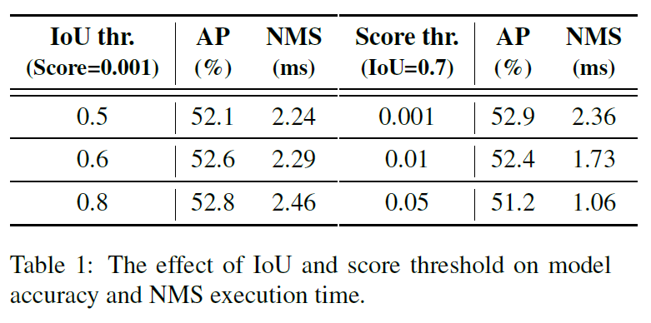
Background
The model accuracy and NMS execution time are affected by:
Number of input prediction boxes,
2 hyperparameters: score threshold & IoU threshold.
(YOLOv8 with TensorRT NMS)

Slide 6
DEtection TRansformer (DETR)

Slide 7
DETR
Formulates the object detection task as an image-to-set problem.
Eliminates hand-designed anchor and NMS.
Fully end-to-end detector.

Slide 8
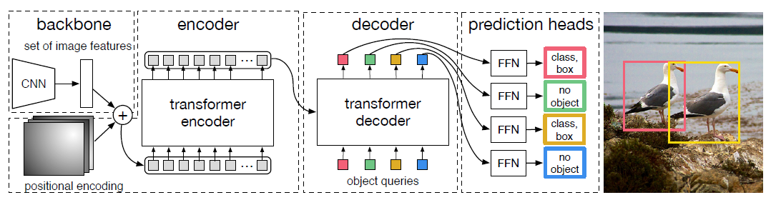
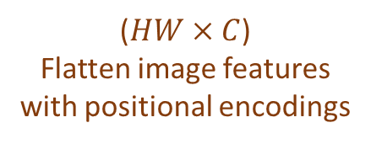
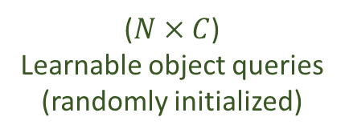
DETR
Overall model architecture:
($HW×C$)
Flatten image features with positional encodings
($N×C$)
Learnable object queries (randomly initialized)
Each object query predicts a detection or “no object” class

Slide 9
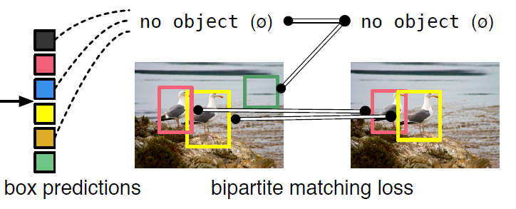
DETR
During training, a set loss function which performs bipartite matching (based on Hungarian algorithm) between predicted and ground-truth objects removes false or extra detections.
Unmatched prediction should yield a “no object” class.

Slide 10
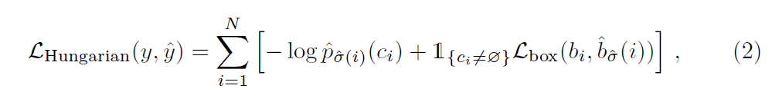
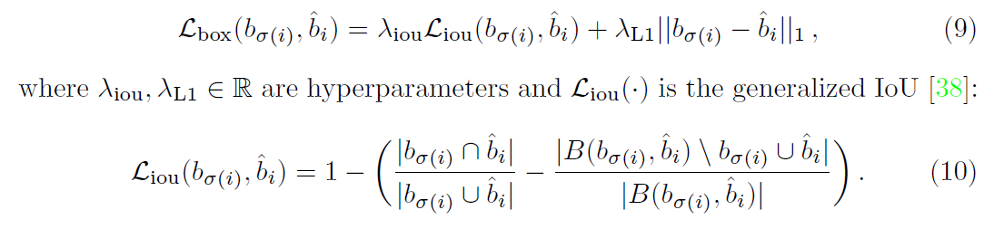
DETR – Loss function
Bipartite Matching - Hungarian loss:

Slide 11
DETR
Advantages:
Fully end-to-end, eliminate the need for hand-crafted components (proposal / anchor generation, NMS).
Drawbacks:
(Because of the attention mechanism)
Requires much longer training epochs to converge.
Has relatively low performance at detecting small objects due to the lack of multi-scale features, which would add unaffordable complexity.

Slide 12
Deformable DETR

Slide 13
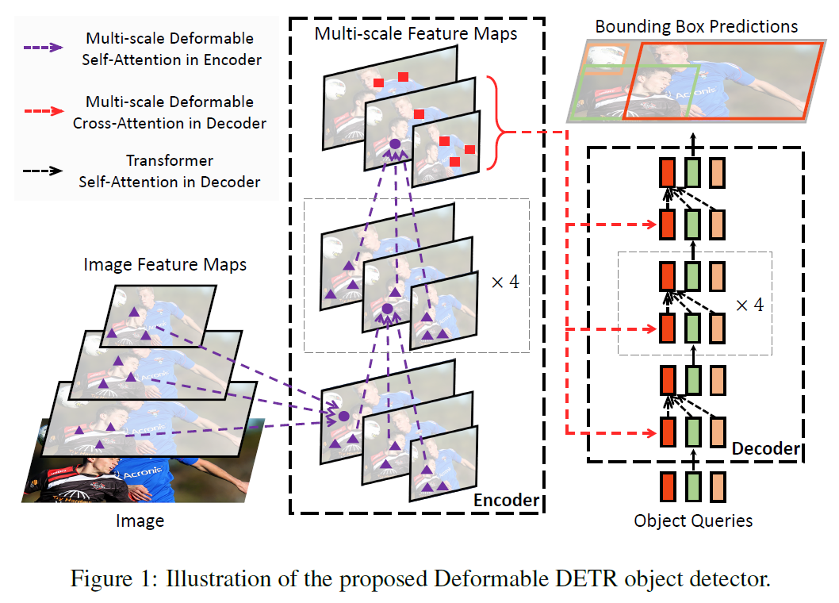
Deformable DETR
Aims to mitigate DETR’s slow convergence and high complexity issues with:
Deformable attention module replacing encoder’s self-attention module and decoder’s cross-attention module,
Multi-scale features.

Slide 14
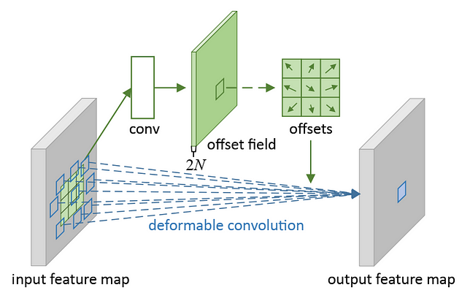
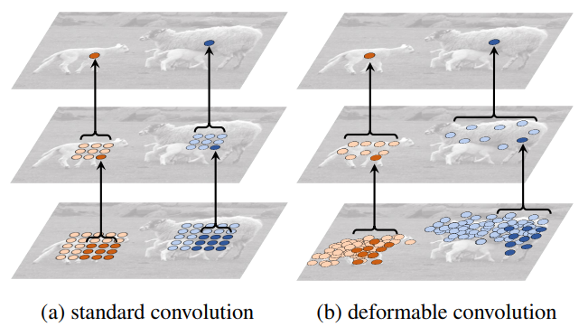

Deformable Convolution (DCN)
2D offsets are added to deform the formerly-fixed sampling grid:
$y\left(p\right)=\sum_{p_{n}∈ℛ}{w\left(p_{n}\right)⋅x\left({p_{0}+p}_{n}+Δp_{n}\right)}$ where $Δp_{n}$ is the offset.
The offsets are learnable from preceding feature maps.

Slide 15
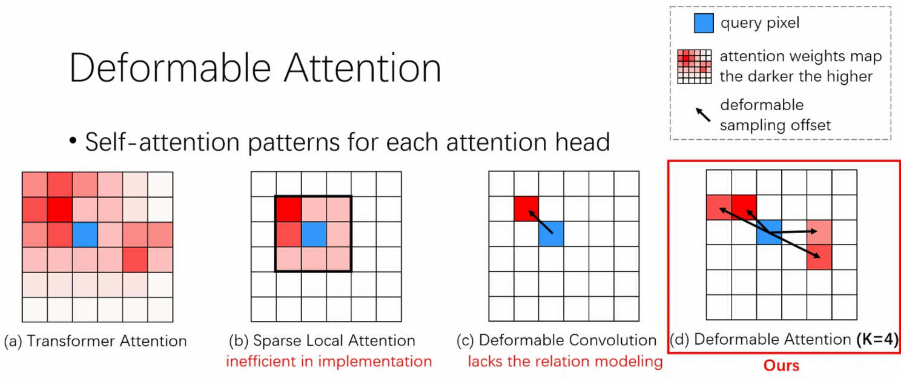
Deformable Attention
Self-attention patterns for each attention head:

Slide 16


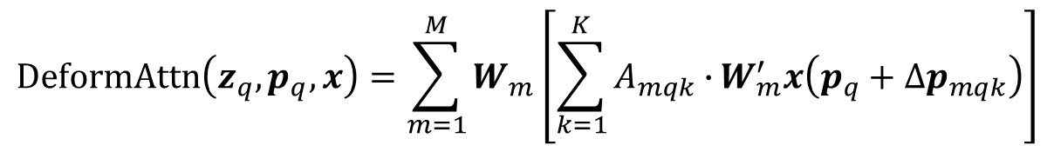
Deformable Attention Module
Deformable convolution’s sparse spatial sampling + transformer’s relation modeling capability.
Equivalent to Deformable Convolution, when $K=1$ and $W_{m}^{′}$ is fixed as an identity matrix.
Equivalent to Transformer Attention, when $K=HW$ and the sampling points traverse all possible locations.
query element
key elements
K is the total sampled key number ($K≪HW$)
$$DeformAttn\left(z_{q},p_{q},x\right)=\sum_{m=1}^{M}{W_{m}\left[\sum_{k=1}^{K}{A_{mqk}∙}W_{m}^{′}x\left(p_{q}+∆p_{mqk}\right)\right]}$$
reference point
sum over attention heads
attention weights
sparsely sampled key feature

Slide 17
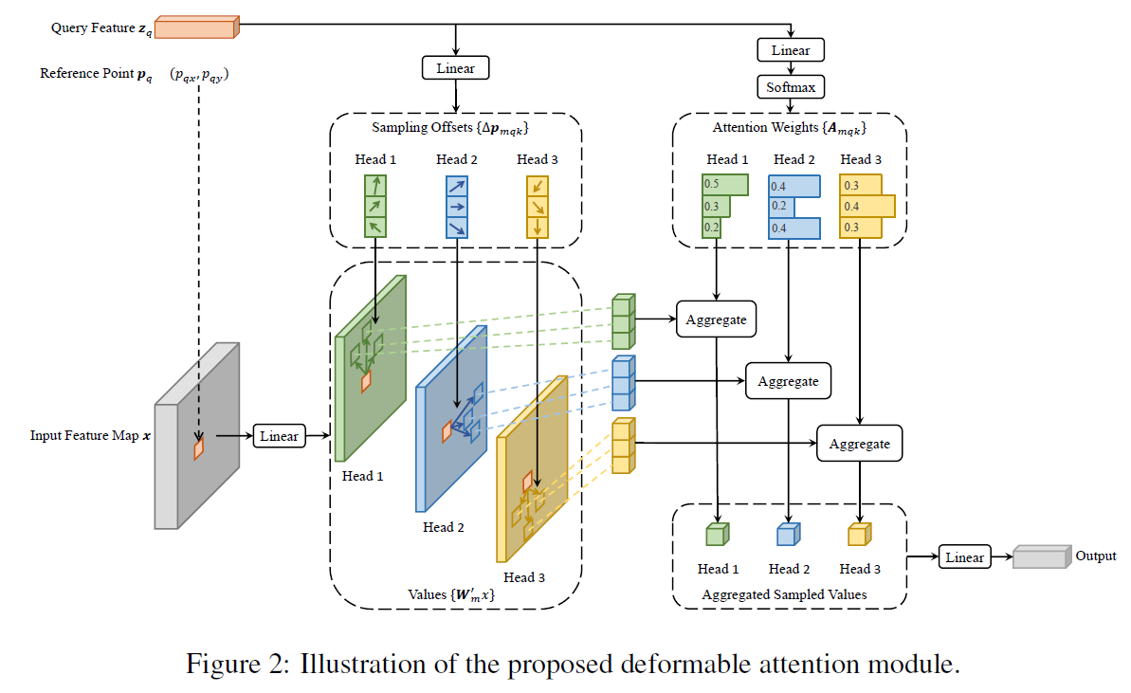
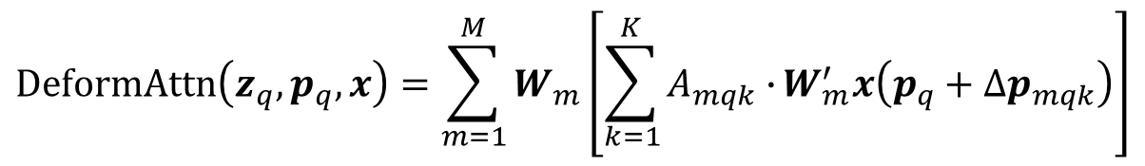
Deformable Attention Module
$$DeformAttn\left(z_{q},p_{q},x\right)=\sum_{m=1}^{M}{W_{m}\left[\sum_{k=1}^{K}{A_{mqk}∙}W_{m}^{′}x\left(p_{q}+∆p_{mqk}\right)\right]}$$
Inputs
Aggregation with attention weights
Output projection
Bilinear sampling of sparse values

Slide 18
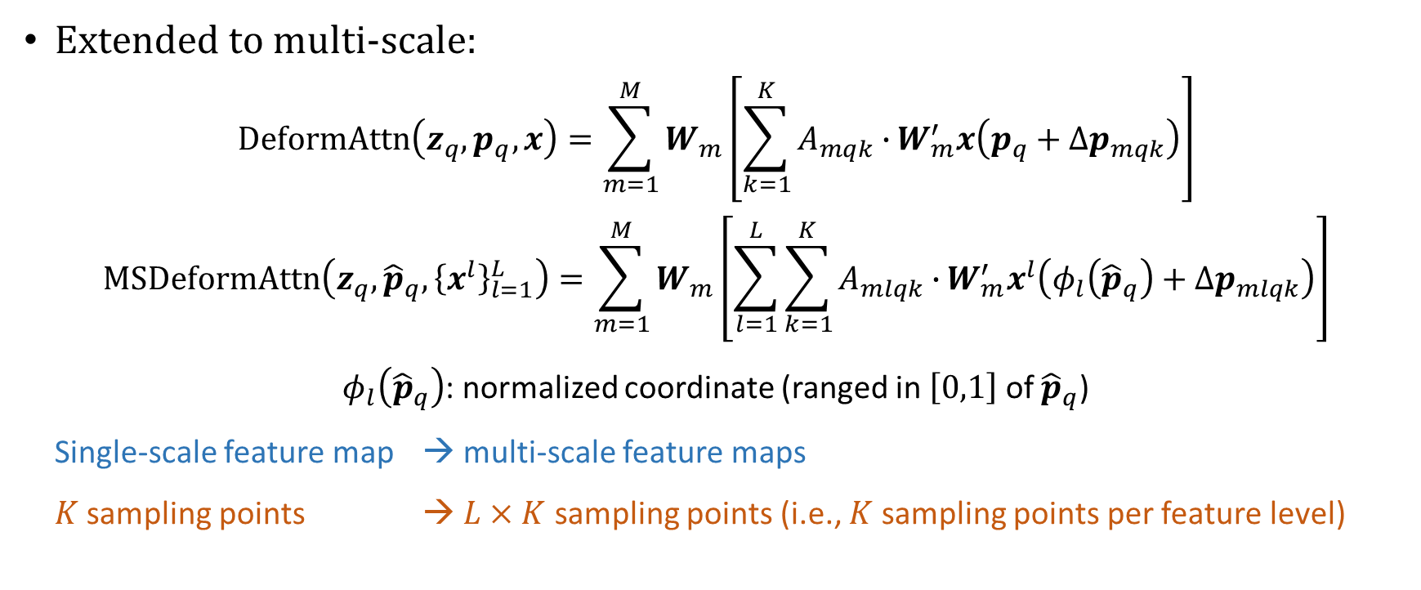
Deformable Attention Module
Extended to multi-scale:
$$DeformAttn\left(z_{q},p_{q},x\right)=\sum_{m=1}^{M}{W_{m}\left[\sum_{k=1}^{K}{A_{mqk}∙}W_{m}^{′}x\left(p_{q}+∆p_{mqk}\right)\right]}$$
$$MSDeformAttn\left(z_{q},{\hat{p}}_{q},{\left\{x^{l}\right\}}_{l=1}^{L}\right)=\sum_{m=1}^{M}{W_{m}\left[\sum_{l=1}^{L}{\sum_{k=1}^{K}{A_{mlqk}∙}W_{m}^{′}x^{l}\left(φ_{l}\left({\hat{p}}_{q}\right)+∆p_{mlqk}\right)}\right]}$$
$φ_{l}\left({\hat{p}}_{q}\right)$: normalized coordinate (ranged in $\left[0,1\right]$ of ${\hat{p}}_{q}$)
Single-scale feature map → multi-scale feature maps
$K$ sampling points → $L×K$ sampling points (i.e., $K$ sampling points per feature level)

Slide 19
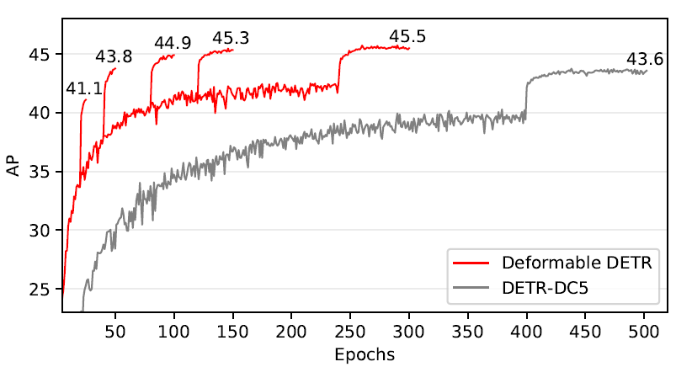
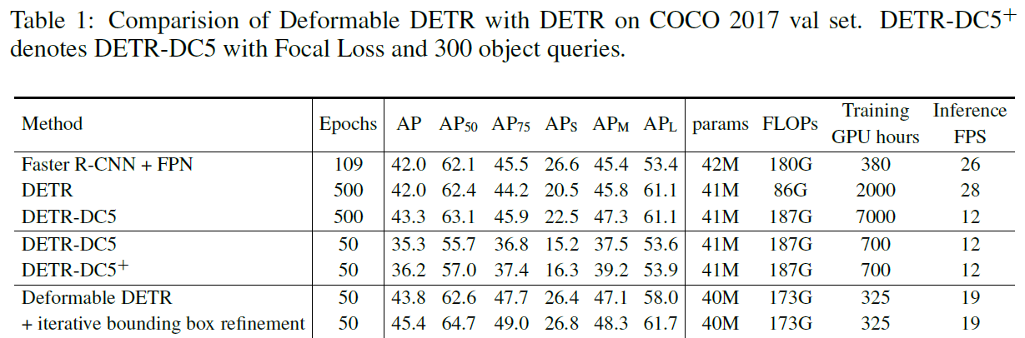
Deformable DETR
Default training schedule
Compared to DETR:
Better performance (especially on small objects)
10x less training epochs
20x less training time
1.6x faster inference speed
Convergence curve
Notes:
DETR-DC5: added dilation to the last C5 stage of the backbone, increases the resolution by a factor of two, at the cost of a 16x higher cost in the self-attentions of the encoder, leading to an overall 2x increase in computational cost.
DETR-DC5+: Focal Loss with loss weight of 2 is used for bounding box classification, and the number of object queries is increased from 100 to 300. Iterative Bounding Box Refinement: inspired by the iterative refinement developed in optical flow estimation (Teed & Deng, 2020), each decoder layer refines the bounding boxes based on the predictions from the previous layer.

Slide 20
Deformable DETR
Advantages:
Multi-scale features improve performance and convergence speed.
Deformable attention reduces computational cost.
Drawbacks:
Multi-scale features significantly increase the length of the input sequence fed into the encoder, causing high computational burden.

Slide 21
RT-DETR

Slide 22
RT-DETR
Simultaneous interaction of intra-scale and cross-scale features is computationally inefficient.
Deformable-DETR’s encoder: accounts for 49% of the GFLOPs, but contributes only 11% of the AP.
→ Decouples the intra-scale interaction and cross-scale fusion of multi-scale features.
It is sufficient to apply the self-attention operation to high-level features with richer semantic information about objects in the image.
The intra-scale interactions of lower-level features are unnecessary.

Slide 23
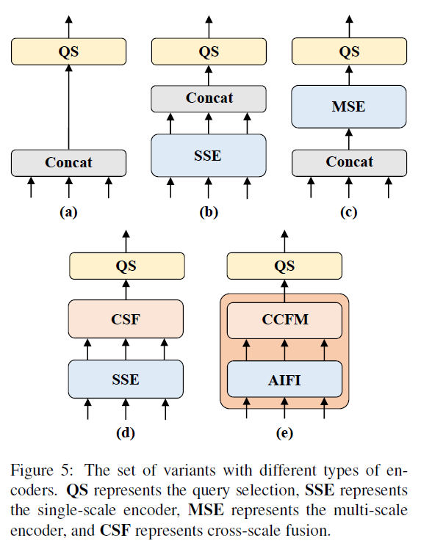
Hybrid Encoder (Ablation)
A: baseline, DINO-R50 with multiscale transformer encoder removed.
B: inserts a single-scale transformer encoder with 1 layer of transformer block, which is shared between scales for intra-scale feature interaction, and then concatenates the output multi-scale features.
C: introduces cross-scale feature fusion and feeds the concatenated multi-scale features into the encoder to perform feature interaction.
D: decouples the intra-scale interaction and cross-scale fusion of multi-scale features. A PANet-like structure is utilized to perform cross-scale fusion.
E: further optimizes the intra-scale interaction and cross-scale fusion of multi-scale features, adopting a new efficient hybrid encoder (explained later).

Slide 24
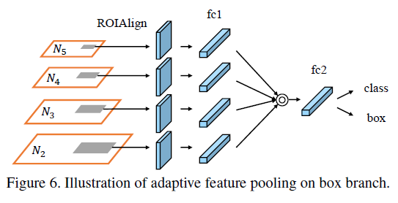
PANet’s Adaptive Feature Pooling
Used as cross-scale fusion module in Variant D of RT-DETR encoder.

Slide 25
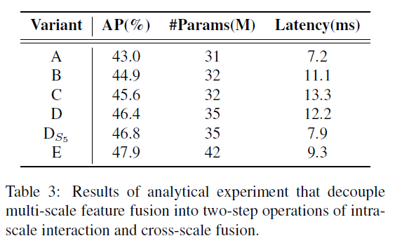
Hybrid Encoder (Ablation)
Notes:
Compared to the vanilla
variant D, DS5 significantly reduces the latency (35% faster)
but delivers an improvement in accuracy (0:4% AP higher).

Slide 26
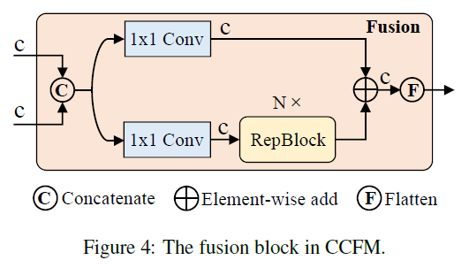
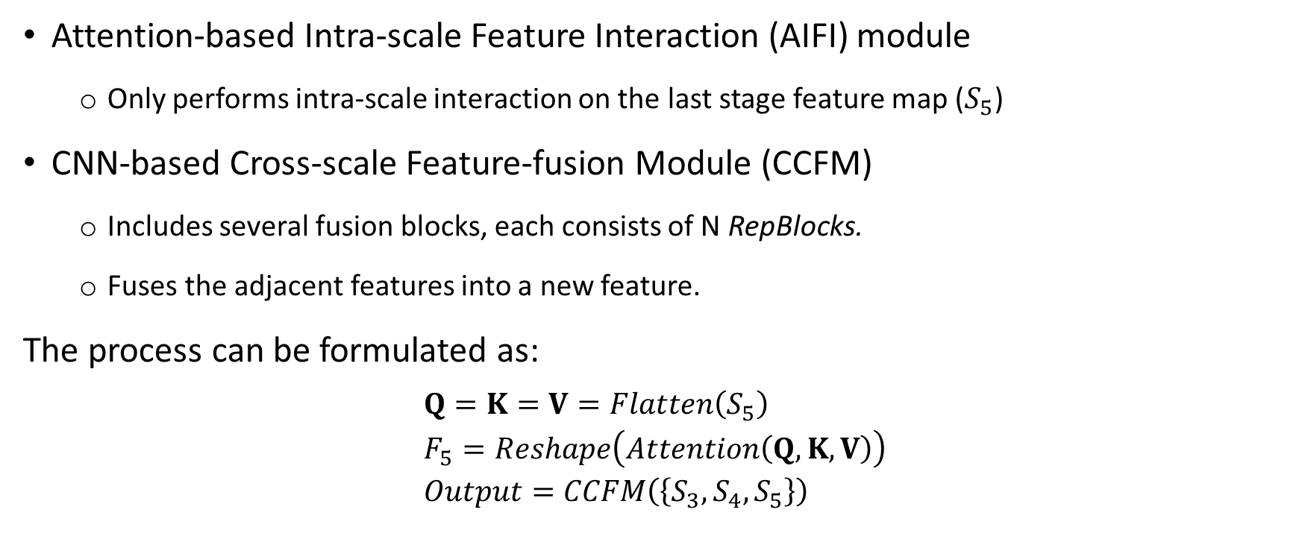
Efficient Hybrid Encoder
Attention-based Intra-scale Feature Interaction (AIFI) module
Only performs intra-scale interaction on the last stage feature map ($S_{5}$)
CNN-based Cross-scale Feature-fusion Module (CCFM)
Includes several fusion blocks, each consists of N RepBlocks.
Fuses the adjacent features into a new feature.
The process can be formulated as:
$$Q=K=V=Flatten\left(S_{5}\right) \\ F_{5}=Reshape\left(Attention\left(Q,K,V\right)\right) \\ Output=CCFM\left(\left\{S_{3},S_{4},S_{5}\right\}\right)$$

Slide 27
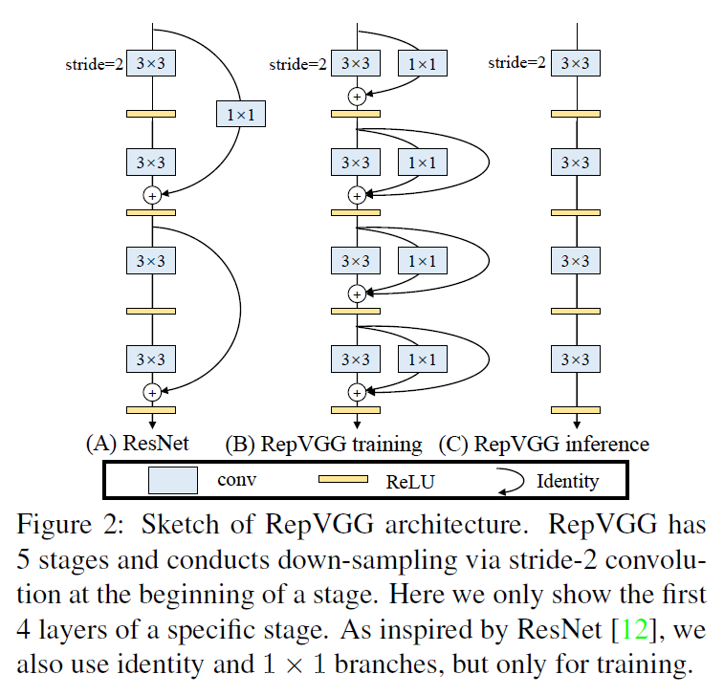
RepBlock
Re-parameterized block: similar to ResBlock but has one more connection with 1x1 filter in between.
Structural re-parameterization: means converting the architecture from one to another via transforming its parameters (between training time & inference time)

Slide 28
Query Selection Scheme
Object queries (DETR):
Set of learnable embeddings mapped to classification scores and bounding boxes.
Difficult to interpret and optimize due to no explicit physical meaning.
Vanilla query selection (Efficient-DETR, Deformable-DETR, DINO-Deformable-DETR):
Utilizes the classification score to select top K features from the encoder to initialize object queries.
Inconsistent distribution of classification score and location confidence → boxes with high classification scores and low IoU scores being selected, while boxes with low classification scores and high IoU scores are discarded.

Slide 29
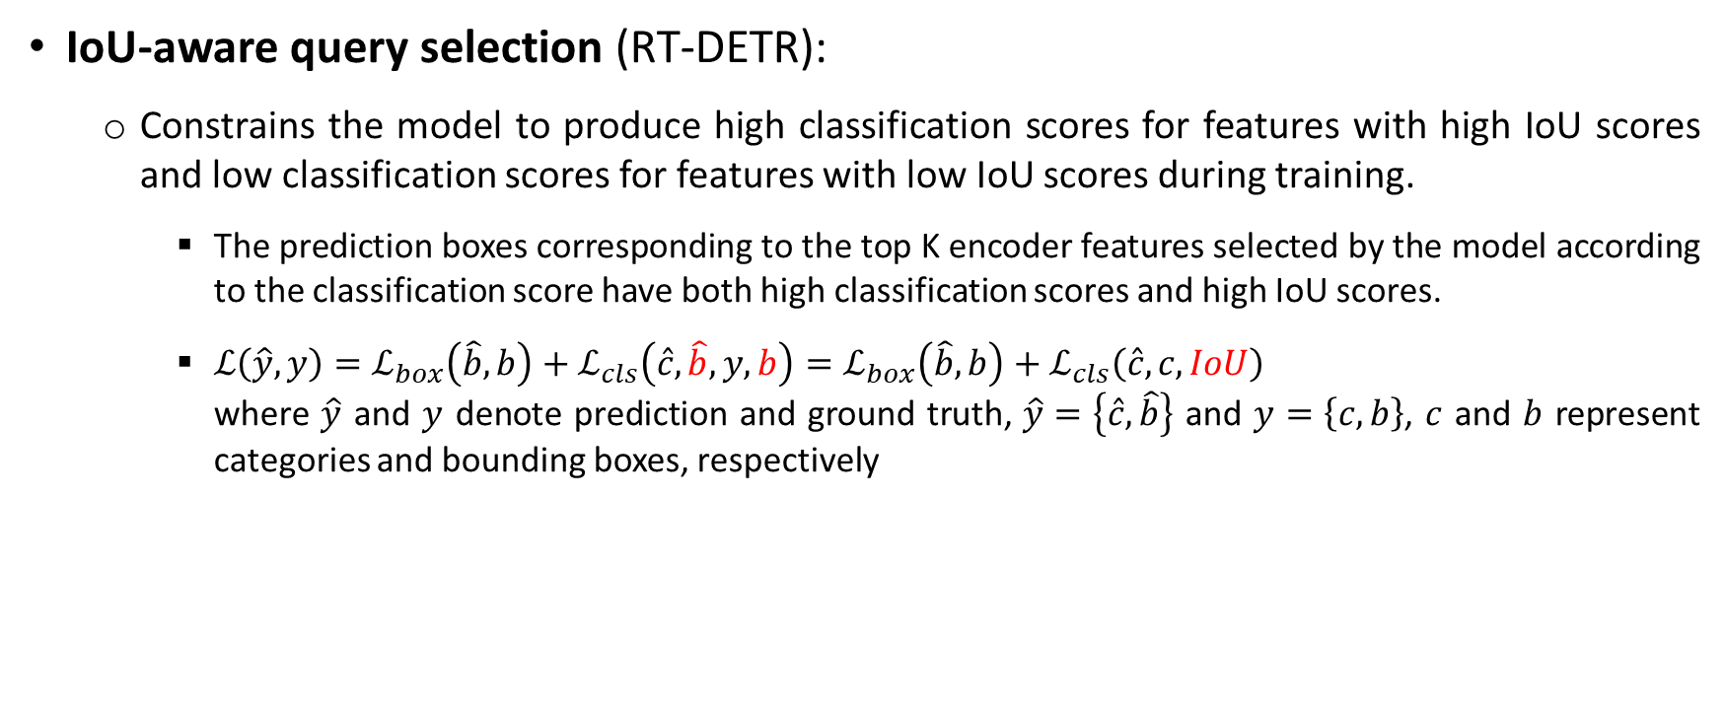
Query Selection Scheme
IoU-aware query selection (RT-DETR):
Constrains the model to produce high classification scores for features with high IoU scores and low classification scores for features with low IoU scores during training.
The prediction boxes corresponding to the top K encoder features selected by the model according to the classification score have both high classification scores and high IoU scores.
$ℒ\left(\hat{y}, y\right)=ℒ_{box}\left(\hat{b}, b\right)+ℒ_{cls}\left(\hat{c},\hat{b}, y,b\right)=ℒ_{box}\left(\hat{b}, b\right)+ℒ_{cls}\left(\hat{c},c, IoU\right)$ where $\hat{y}$ and $y$ denote prediction and ground truth, $\hat{y}=\left\{\hat{c},\hat{b}\right\}$ and $y=\left\{c,b\right\}$, $c$ and $b$ represent categories and bounding boxes, respectively

Slide 30
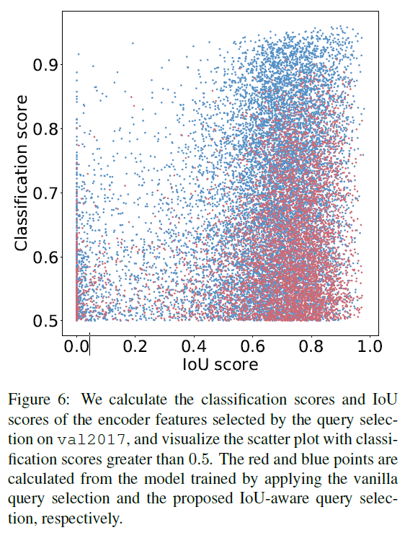
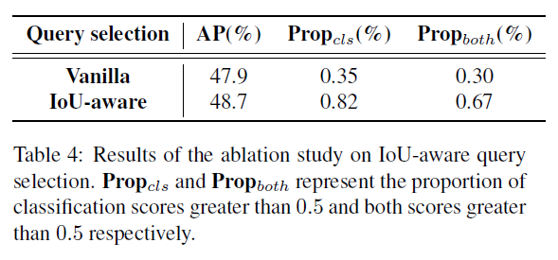
Query Selection Scheme (Ablation)

Slide 31
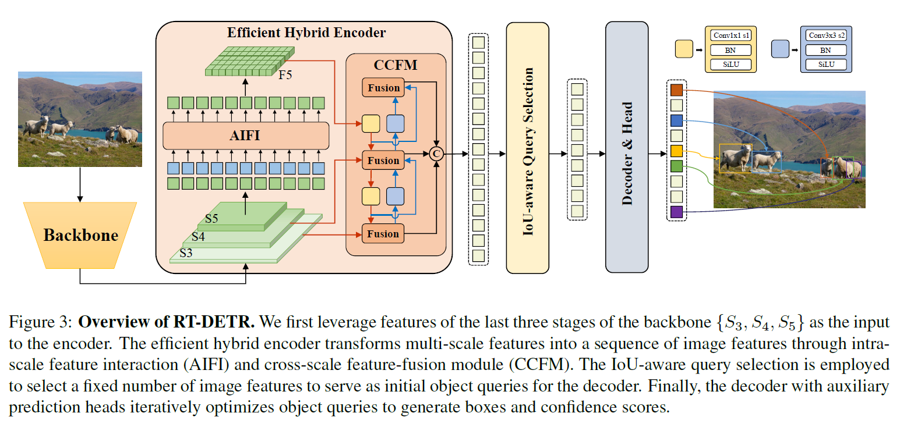
RT-DETR

Slide 32
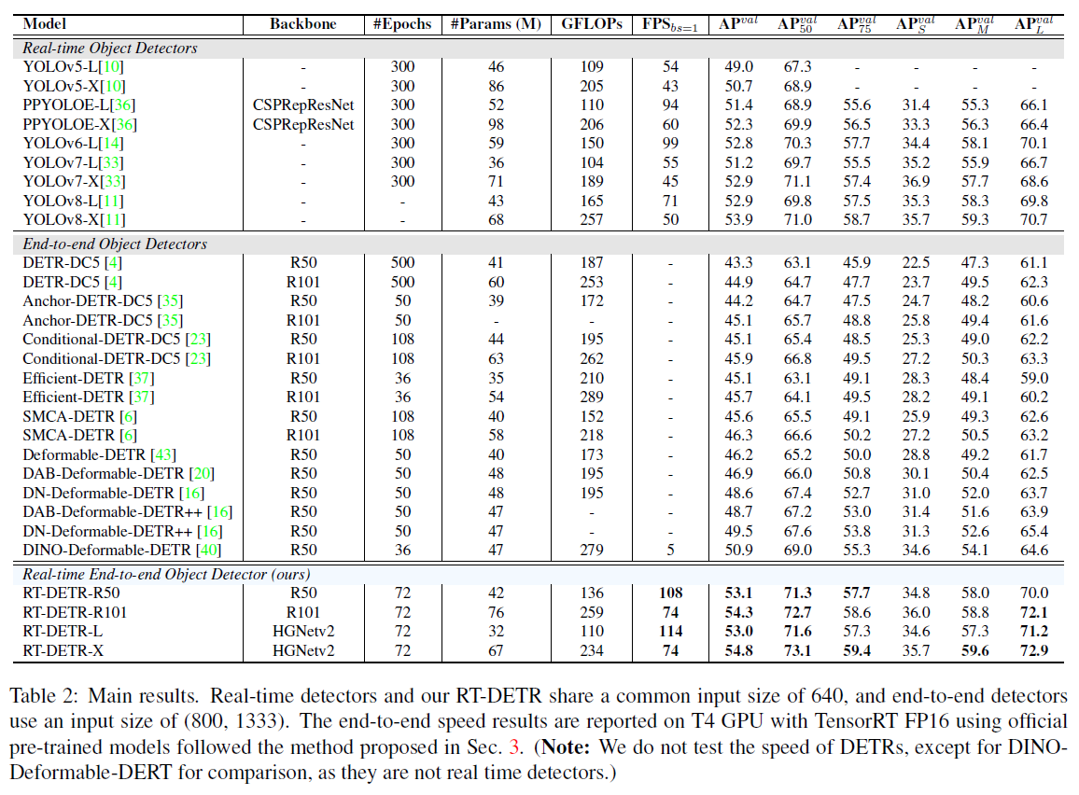
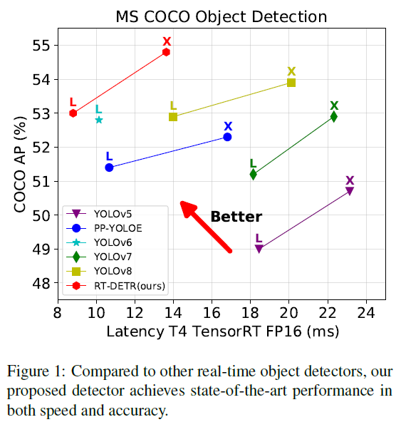
Experiments Result (COCO 2017 val)

Slide 33
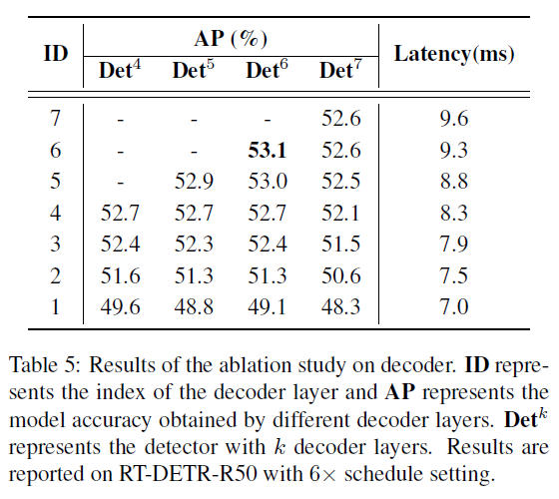
Ablation
Model accuracy obtained by different decoder layers

Slide 34
Conclusion
A detailed analysis of NMS on real-time detectors (Slide #5).
A real-time end-to-end detector that includes:
A hybrid encoder that can efficiently process multi-scale features.
IoU-aware query selection that improves the initialization of object queries.
The proposed detector supports flexibly adjustment of the inference speed by using different decoder layers without the need for retraining, which facilitates the practical application of real-time object detectors.

Slide 35
Thank you for your attention

Slide 36
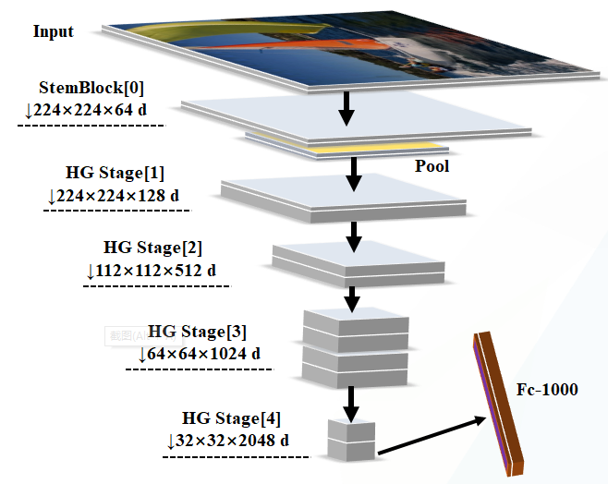
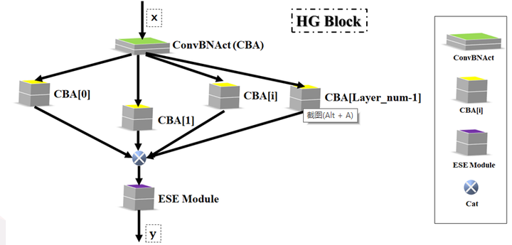
HGNetv2
Each HG Stage is mainly composed of HG Blocks containing a large number of standard convolutions.

